Slide 1
BASKETBALL COACH AS A PSYCHOLOGIST

Slide 2
Psychological preparation of a basketball player is the process ran by a coach in order to help a sportsman to master mental skills i.e. how to relax, rest, recover, increase concentration, motivation, self-confidence and to overcome the stress.
The coach-player, coach-parent, coach-coach, coach-managing board are relations in basketball

Slide 3
Improving the team functioning – coaches like to name themselves the best psychologists.
Dusan Ivkovic’s words for Euroleague website:
“A coach must be a psychologist. He must know soul of a player, to enter their heads and hearts and see what’s inside. He must talk to a player in private or in the locker room. I don’t like having a psychologist within the team since I find redundant to put the third person between a coach and a player.“

Slide 4
The momentary sport achievement is 80% -95% determined by psychological status
-The Australian swimming team has 6 psychologists.
-In Germany, it’s by the law that every football team has a sport psychologist.

Slide 5
-Carlo Ancelotti, on his transfer to Chelsea FC, takes Bruno Demichelis – the sport psychologist - with him

Slide 6
Sport psychologists do not work with everybody but only wth the privileged, and physically strongest people.
The “one man knows everything” principle is wrong. Pay attention to the Novak Djokovic’s team. The greatest misapprehension is to consider a person doing mental training an eccentric one.
Federer used to be extremely
impulsive in junior category.

Slide 7
Prejudices:
1. Psychological preparations have no effect
2. A sport psychologist cures ( he isn’t a
doctor, he teaches mental skills)
3. A sport psychologist does tests only
4. Psychological preparations are intended for
top-level sportsmen only
5. Psychological preparations are transitory

Slide 8
To teach a coach how to create the atmosphere in trainings which will engage and retain
basketball player within a training process and, that way, produce the basic assumption for positive influence of sport on the development of a sound personality.

Slide 9
COACH’S ROLE
The coach is a central person of organization
- His activities are quite extensive, they exceed the role of technique teacher and require the coach to extend the spectrum of his knowledge and interests.
-He must be quite familiar with elements of physical preparation, psychology, sociology and medicine.

Slide 10
The coach’s entire work is
a permanent expriment
The coach’s entire work in a training process is
a constant and never ending experiment.
Actually, through an operational work with
basketball players, the coach discovers and
applies new methods and levels of load in
trainings and competitions.

Slide 11
The goal i.e. top-level result can’t be achieved
without conversance of the basketball player’s
characteristics and abilities and without
conversance of planning and programming the
training process, realization, keeping record of
the conducted trainings, analysis and
correction.

Slide 12
One of the general goals of sport is
physical activity i.e. physical training which has 2 levels:
1.Pedagogical – upbringing and education
through sport’s basic values
2.Socio-psychological - a human’s need for
soul-searching and personality development

Slide 13
COACH AS A TEACHER
Runs the training process in an organized and
systematic manner, evaluates individual results
and the quality of a team, selection and
management.

Slide 14
CONDITIONAL COACH
Takes care of young players' physical
preparation individually, as well as senior
players. Develops motor skills of players and a
team. Plans and maintains good shape
according to the annual cycle, macro and micro
cycles within a season.

Slide 15
COACH AS A REFEREE
In almost every training, he does the role of a
referee. He introduces players to the rules,
often does refereeing in trainings and
unofficial games . Keeps up to the rules
changes and applies them in a training
process.

Slide 16
COACH AS A DOCTOR
He often amends the club physician. During his
absence, the coach is the one who notices injuries
first and reacts. He possesses certain knowledge in
physiology and first aid.

Slide 17
COACH AS A PEDAGOGUE
By his attitude toward a young man – basketball
player, he has a great influence at the physical and
social maturing during the most sensitive period –
adolescence.

Slide 18
COACH AS A PSYCHOLOGIST
Solves the personal and interpersonal problems of
basketball players, understands certain phenomena
and reacts with his attitude, keeps a good working
atmosphere.

Slide 19
COACH AS A LEADER
Must possess a high level of basketball knowledge, he’s not a leader on the domain of creating expert work only but the entire club and more.

Slide 20
COACH AS A MANAGER
Coaching activity encroaches the managing
segment since the coach predicts development of a
club, concurrence and results; he deals with human
resources policy through selection and positioning
of places within the team.

Slide 21
WHAT ARE THE COMMONEST PROBLEMS THE BASKETBALL PLAYERS COME ACROSS?
1.Wavering of motivation, self-confidence
and concentration
2.Stage fright, fear of success or failure.
3.Anxiety before a very important competition
4.Struggle with various expectations
5.Overcoming the feel caused by a failure
6.Fear of non-repetition of an achieved success

Slide 22
7.To big stress, trained excessively,
frequent injuries
8.Satiation from sport – the wish to quit
9.Inability to control the emotions
10.Discontent with the club, coach, players
11.Inability to fit into the collective

Slide 23
MANAGING THE GOALS IN BASKETBALL
When the reason for entering the basketball
becomes the source of systematic coaching work,
we talk about the sport goal i.e. substantiation of
sport dream and that’s when we make an action
plan.

Slide 24
MASTER
1.MEASURABLE – I want to have a better shot. I want to have a 50% of three point shot.
2.ADAPTIVE – Flexible, possible small corrections due to the conditions we couldn’t predict in the beginning.
3.SPECIFIC – I want to be the best player. No! Actually, I want to improve
my jump shot and passing

Slide 25
4.TIME – A timely determined goal. The basketball players often set themselves short deadlines.
5.ENCOURAGING – zestful, encouraging. Formulation of the goals should be positive e.g. reduce the number of mistakes or increase the number of successful executions.
6.REALISTIC – Objective estimation of an individual – demanding but attainable

Slide 26
MENTAL TRAINING
the way of overcoming critical moments
The “mind over muscle” metaphor depicts the
necessity of psychological component in top
level performance without which achieving of a
top-level result is impossible.

Slide 27
Sport psychology is at home with “the weakest
link” principle (wherein the links are technical
tactical preparedness, conditional and
psychological preparedness, body…). The current
sport maximum isn’t determined by what we’re
superior in but the opposite – it’s determined by
our weakest domain.

Slide 28
The praxis notes the following:
-Inability to play during a game the way it was in the trainings.
-Non-constancy of the play, oscillations in play from game to game
CRITICAL MOMENTS
1.Perfectionism
2.Appearance of doubt
3.Advent of emotions
4.Decrease/increase of
adrenalin and energy
5.Overanalyzing
6.Negative thoughts

Slide 29
THE CONCEPT OF MENTAL TRAINING
Mental training is the training focused on basic mental (psychological) skills aiming to improve sport performance.
Basic mental skills:
1.ACTIVATION – arousal, level...for example - Wake up, are you present?
2.IMAGINATION – Engagement of all senses in creating an image of performance e.g. practicing the tactical plan without
physical activity

Slide 30
3.SPEECH/CHEERING – Speech only, e.g.
“Let’s go, that’s right…”
4.GOAL SETTING – short term and long term e.g. “I’ll score 8 free throws”. It raises self-confidence and it helps in
learning from mistakes.

Slide 31
-Whom the mental training is intended for?
Anybody, regardless of the level
-Where does the mental training take place?
Anywhere – consulting room, gym,
dressing room…
-Is the mental training compulsory?
No, it’s voluntary.
-What form does the mental
training take place in?
Individual, with the team, with coaches

Slide 32
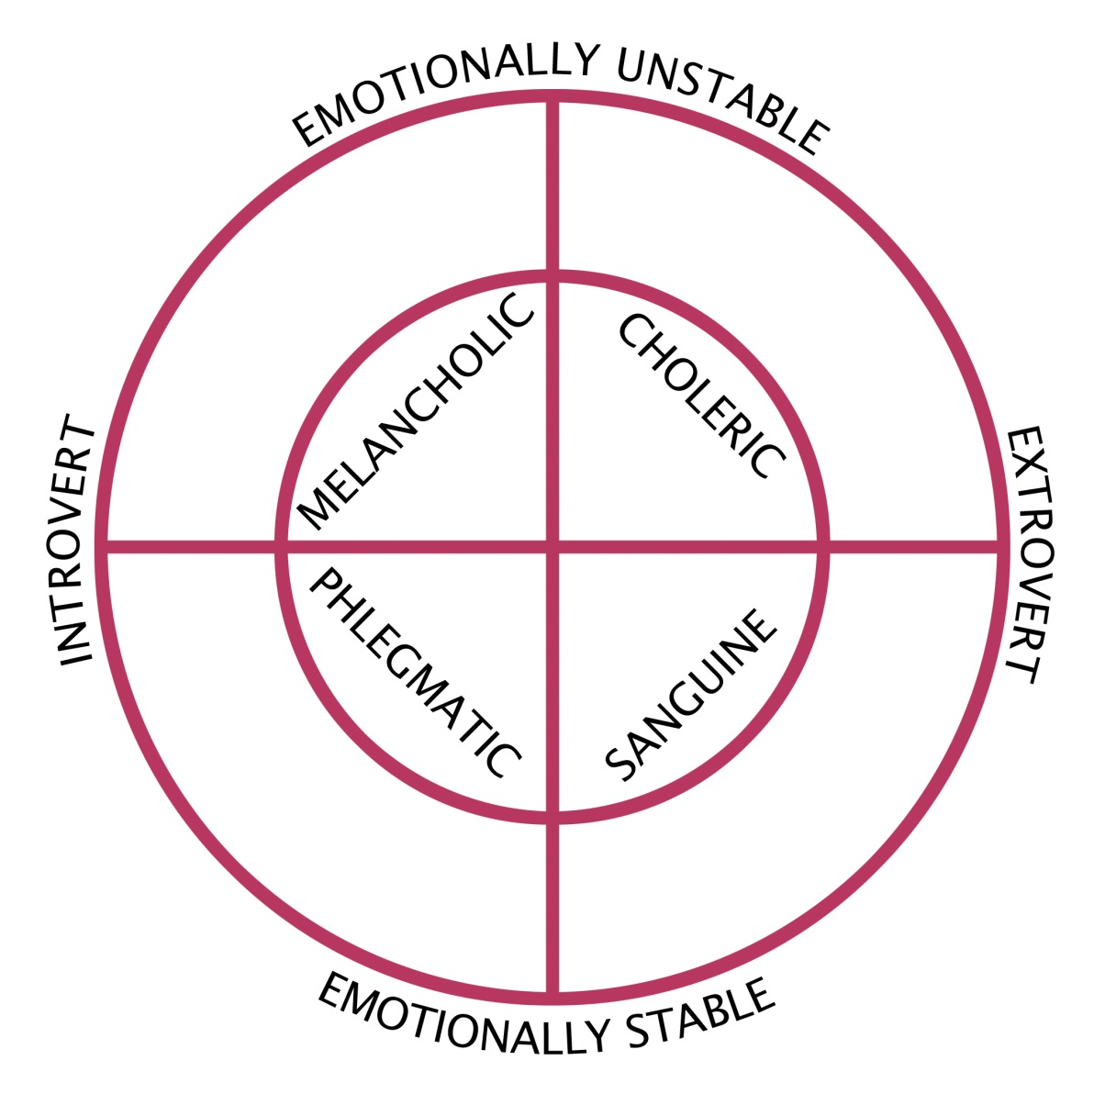
4 TYPES OF PERSONALITY
ACCORDING TO HIPPOCRATES

Slide 33
1.CHOLERIC – aggressive, impulsive, pesimistic
2.SANGUINE – bright, cheerful, optimistic
3.PHLEGMATIC – calm, moral, optimistic
4.MELANCHOLIC - non-sociable, rigid, pesimistic

Slide 34
An introvert person hardly establishes social relations. These people turn themselves inward, they’re self-sufficient.
An extrovert person is an open-faced one, they keep on struggling for being in centre of interest and are open to the world

Slide 35
ALEXANDER GOMELSKI - “GAME MANAGEMENT”
-Game preparation
-A meeting before the game
-Timeout
-Quarters
-Half-time
-The end of the game

Slide 36
Vlada Djurovic won the Championship of Yugoslavia with “small” teams, Sibenka BC and Zadar BC, despite Red Star BC, Cibona BC and Partizan BC and all the people agreed that psychological preparation of players had brought the victory.

Slide 37
A million talents failed because of psychology.
Do not allow the psychological factors to get in
your way to top-level results.

Slide 38
Q&A

Slide 39
Thank You for
your attention!
Milan Opacic

